Slide 1
Big Mountain Resort Pricing Recommendations
Shakuntala Mitra

Slide 2
Problem Identification
Big Mountain Resort added a new chair lift to the park, which increases their operating costs by $1,540,000 this season
Need to decide if the ticket price should be increased to support this increased cost
The current pricing strategy is to charge a ticket premium above the average market price.
We need to develop a data-driven strategy to support or increase the ticket price so that we can best utilize the park’s assets and invest for the future

Slide 3
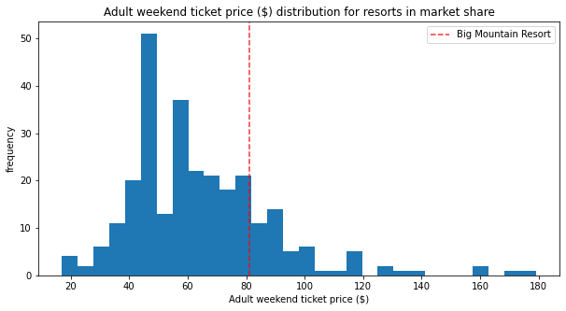
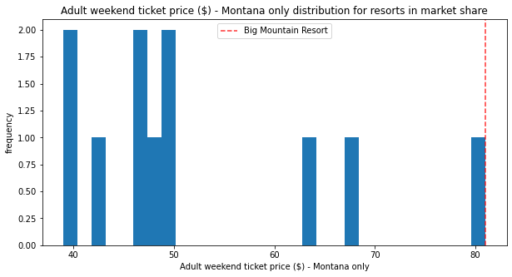
Ticket Price Comparisons
Big Mountain Resort currently charges $81.00 for each adult ticket. This is very high for Montana, but just above average for the overall market range. The resort sees ~350,000 visitors annually, who on average buy 5 day tickets. Taking all of this into consideration, the modelled price is $95.87. Even with the expected mean absolute error of $10.39, this suggests there is room to increase the ticket price.

Slide 4
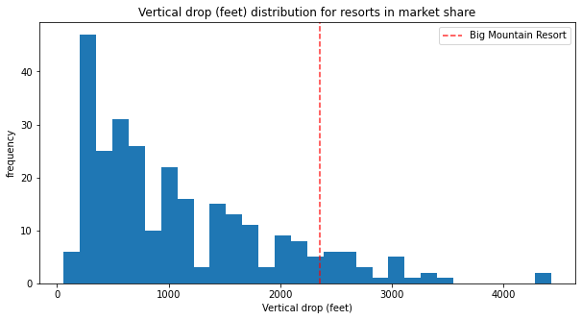
Modeling - Increasing Vertical Drop
The most profitable modeled option would be to increase the vertical drop by adding a run to a point 150 feet lower down, but requiring the installation of an additional chair lift to bring skiers back up, without additional snow making coverage.
This increases support for ticket price by $1.99. Over the season, this could be expected to amount to $3,474,638.
This increase in revenue would be enough to support the operation costs of two more added chair lifts! This model also already accounts for the new chair lift that was added for the upcoming season.

Slide 5
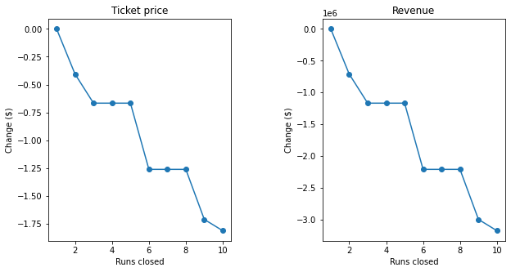
Modeling - Closing Down Least Used Runs
Closing one run does not affect ticket price or revenue, but closing runs two and three successively reduces support for ticket price.
If Big Mountain Resort can afford to close down three runs, we may as well close down four and five as well, as there's no further loss in ticket price. Increasing the closures down to six or more runs leads to a much larger drop in revenue.
Profits and costs should be reassessed after closing runs 1, 2, and 3.

Slide 6
Recommendations & Key Findings
The most impactful features of Big Mountain Resort for ticket price and revenue are the vertical drop, total chairs, fast quad lifts, number of runs, longest run length. Big Mountain is near the top of the market for total chairs, fast quads, and longest run length.
Of these areas, Big Mountain Resort stands to improve the most by increasing the vertical drop, as there are many resorts in the market with a much higher vertical drop. Over the season, this could lead to a $3,474,638 increase in revenue, which would be enough to support the operation costs of two additional chair lifts!
Closing down up to six of the least used runs in the park could also be profitable if the money saved on yearly operating and maintenance costs for these runs would be greater than the yearly revenue generated by keeping them open (thus making up for the cost of closing these runs).
Additional details of operation and maintenance costs for the equipment and areas of the park would be very helpful in further informing these recommendations.

